Slide 1
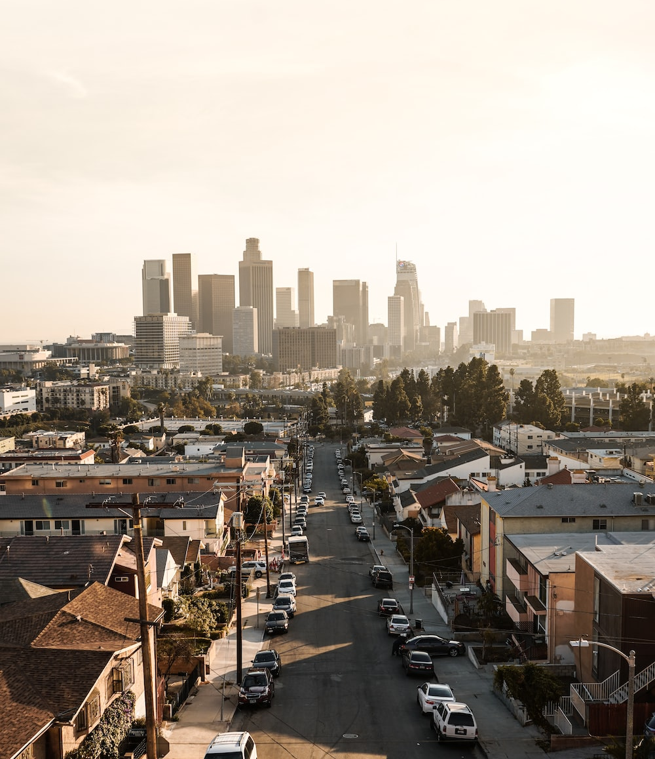
Los Angeles Crime Analysis
David Simms
July 3, 2023
Notes:
Line spacing + Page numbers

Slide 2
Agenda
01 Introduction and Methodology
02 Analysis
03 Summary
04 Closing

Slide 3
Introduction and Methodology
01
This dataset contains crime data for Los Angeles, California, obtained from the US Governments Open Data website, provided to me by Lanark, Leeds and Grenville Addictions and Mental Health to analyze and present.
The dataset contained 999 rows with 20 features each.
The data was cleaned and analyzed in Jupyter Notebook using Python and its data analysis packages.
There was no data dictionary included with this data. Column names were not descriptive. This led to the removal of the “Descent” column as I was unable to determine the column labels.

Slide 4
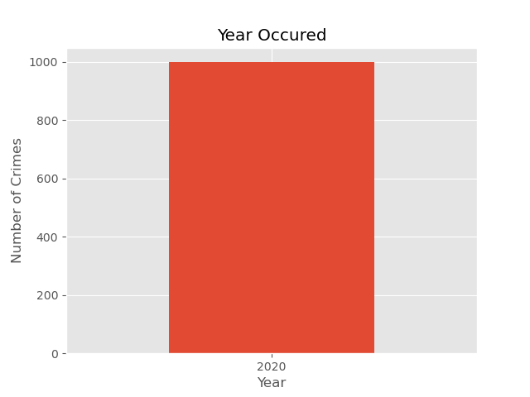
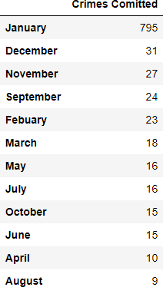
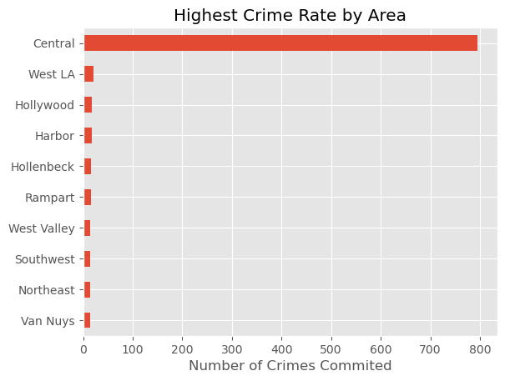
02
Analysis
The first step in the Analysis was cleaning the data. During cleaning it was revealed that the data was almost entirely from January 2020 in Central LA.
Thus, this analysis of LA Crime data became an analysis of Central LA crime data for the period of January 2020.

Slide 5
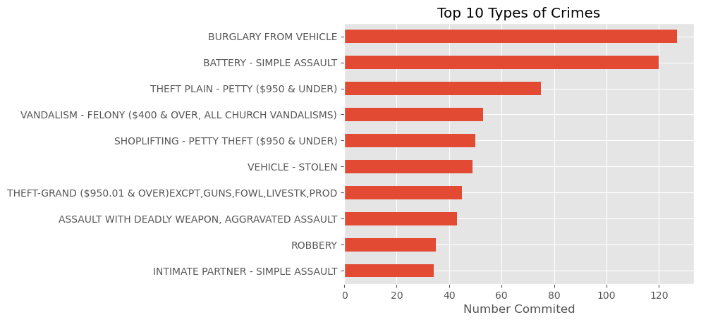
02
Analysis
The top 2 crimes, both representing about 10% of crimes committed, were “Burglary from Vehicle” and “Simple Assault”. Simple Assault in California is intent to inflict injury.
Most crimes occurring are petty crimes, theft, and vandalism. Violent crimes account for roughly 8-10% of crimes.
All types of crime remaining accounted for less than 5 % each (60 + types of crime.)

Slide 6
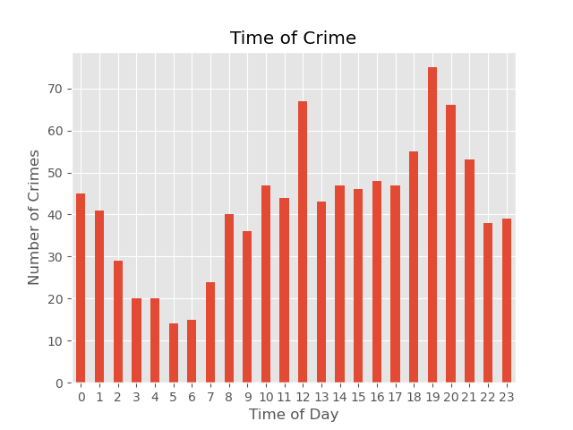
02
Analysis
Unfortunately, I could not visualize any crime trends over time due to the data being entirely from January 2020. However, we can visualize the crime occurring by hours of the day.
The Safest Time of day is 5-6 am. Crime peaks at 7-8 pm with roughly 75 crimes per hour.
Crime is also high at noon compared to the hours around noon. There was no trend to the types of crime committed at noon.

Slide 7
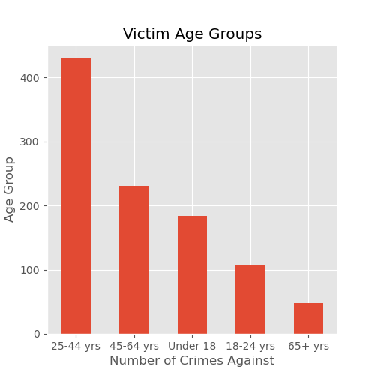
02
Analysis
We can see here that 25-44 year-olds are victims of almost 40% of all crime in January 2020.
Almost all crimes for Under 18 are likely misreported. There was a significant count of victims of the age 0 which turned out to be a placeholder value for many crimes where age was not recorded.

Slide 8
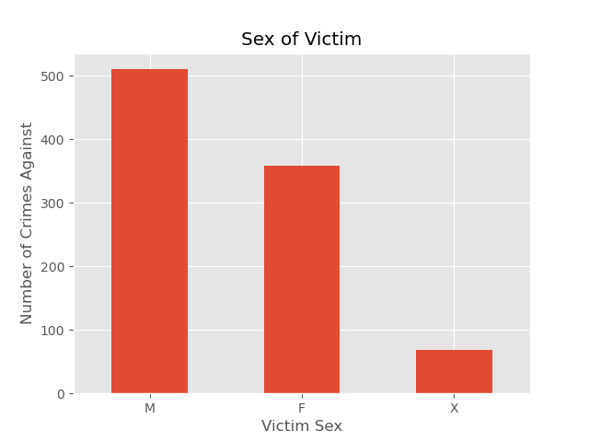
02
Analysis
Just over 50% of crimes were committed against males, 35% against females, and about 8% were against X.
7% of the crimes did not have the sex of the victim reported.
Unable to analyze by Victim Descent due to the lack of a data dictionary. H had 30%, W 23%, and B 18%.

Slide 9
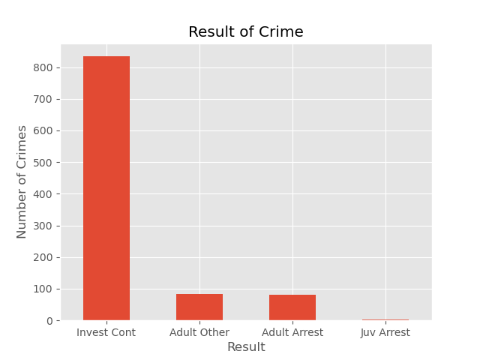
02
Analysis
Over 80 % of reports result in an investigation. 10-20% result in an arrest, depending on what “Adult Other” means.

Slide 10
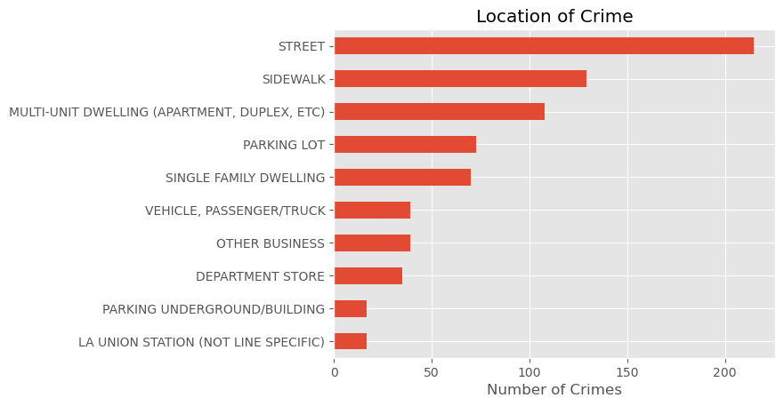
02
Analysis
Between parking lot, sidewalk, Underground parking and street, crimes outside account for almost 50% of all crimes reported.
20 % of crimes occur inside family dwellings.
Businesses and vehicles make up the rest of reported crimes.

Slide 11
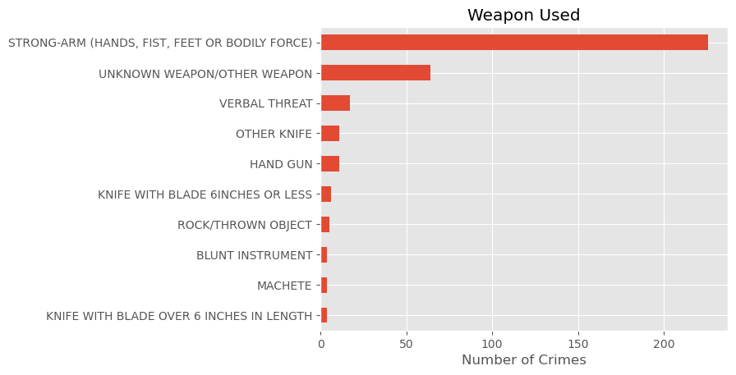
02
Analysis
The type of weapon was only recorded in 30 % of all crimes, but most recorded crimes occurred with no weapon.
Guns were used in only 10 crimes out of 300 recorded.
Most crimes are committed unarmed. Guns were used in only 1% of reported crimes with the weapon type captured.

Slide 12
Summary
03
Types of Crime and Weapon Vehicle Burglaries are the most common type of crime in Central LA. Overall, Crime is mostly a mix of petty crime, theft, and vandalism. Roughly 10 % of crimes were Violent crimes. Most reported crimes were weaponless, and guns do not seem to be a major problem. | Victim Age 60 % of all victims are adults aged 18-64. Only 5% of victims are elderly. There was 172 reports for victim aged 0 which is likely a placeholder for unknown victim age.
Time of Crime The safest time of day is 5-6 AM. Crime peaks at 7-8 pm, with a similar peak at noon, which is a spike compared to the hours around noon. | Victim Sex and Descent Victim Sex was 50% male, 30% female, and rest likely unknown. There was no trend to the type of crime by sex. Victim Descent was not analyzed.
Location of Crime Crimes outside account for almost 50 % of reported crimes. Inside family dwellings are almost 20 %, and business / vehicles the rest. | Result of Crime Most crimes (~80%) do not result in immediate arrest. The average Time to Report a crime was 30 days.

Slide 13
Closing
04
Petty crimes such as theft, vandalism, and simple assault seem to be the major cause of crime in Central LA in January 2020.
In the future, we suggest a more robust data set that will allow a better analysis of the locations, time, and types of weapons used for a better overall analysis of crime in the city of Los Angeles.

